Slide 1
COVID-19 Education for student athletes
fusd

Slide 2
The COVID-19 pandemic has presented many challenges to our daily lives, including returning to school and athletics. As we begin to bring back student athletes (you!) to campus for conditioning only, it's important that you know:
How the virus spreads
Steps you can take to reduce your risk of getting sick
How to prepare yourself to participate in physical activity

Slide 3
It's important to understand how COVID-19 spreads. Since we don't have a vaccine, the best way to prevent this illness is to avoid being exposed. The virus is thought to be spread:
Between people in close contact with each other
Through respiratory droplets when an infected person coughs, sneezes, or talks
Possibly from people who are not showing symptoms
What are some symptoms of coronavirus?
Fever or chills
Cough
Shortness of breath or difficulty breathing
Fatigue
Muscle or body aches
Headache
New loss of taste or smell
Sore throat
Congestion or runny nose
Nausea or vomiting

Slide 4
To limit the spread, be sure to:
Clean your hands often, for at least 20 seconds, either with soap and water or a hand sanitizer that contains at least 60% alcohol
Avoid close contact with people who are sick
Cover your mouth and nose with a mask in public settings and when you are around people outside of your household
Put distance between yourself and others (at least 6 feet)
Cover your cough or sneeze with a tissue and throw it in the trash
Did you know?
People of any age with underlying conditions such as heart disease, asthma, diabetes, obesity, and high blood pressure may be at an increased risk of serious illness if they become infected.

Slide 5
We know that the risk of spreading COVID-19 can be different based on the type of activity.
The more people that you interact with, the closer the physical interaction, the more sharing of equipment that there is by multiple players, the higher the risk of COVID-19 spreading.

Slide 6
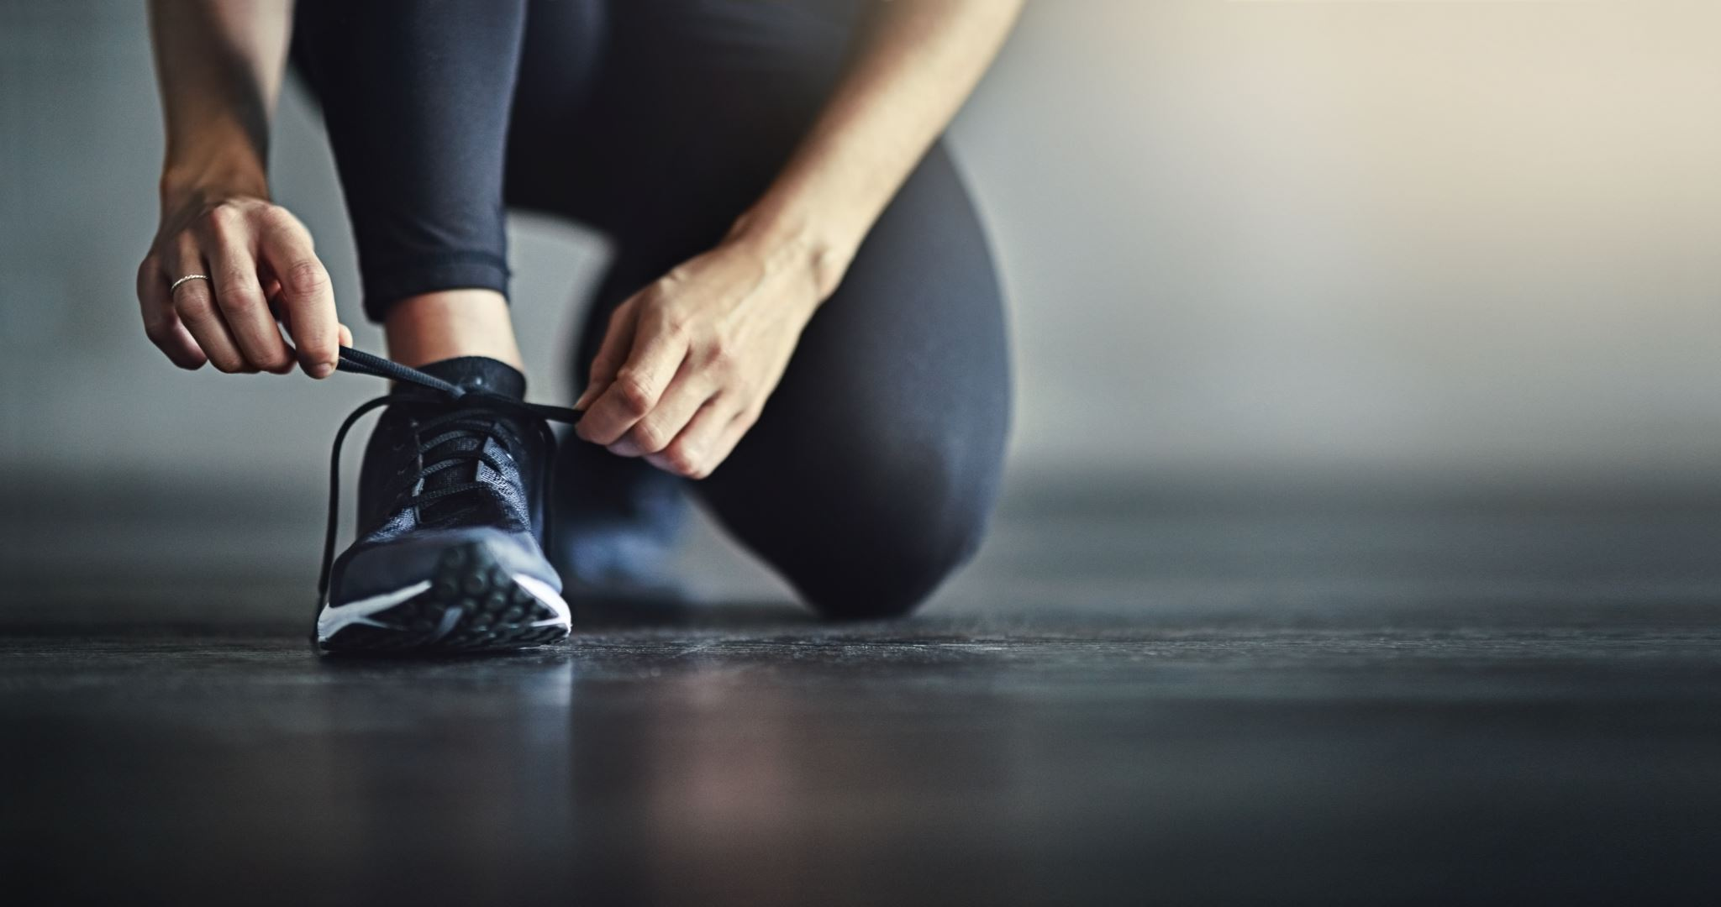
We know that you have missed participating in team activities during this time. It is the District's top priority that we bring you back on campus to condition with your teammates as soon and as safely as possible! To ensure that you stay at a low risk of infection, we will only be allowing conditioning on campus with your teammates.
Safety measures and rules will be in place and MUST be followed. In preparation for coming back, please make sure that:
You wear a mask when you come to campus. You will always need to keep it on, except during vigorous activity, running, or swimming
You MUST remain at least 6 feet apart from your teammates and coaches
You bring plenty of fluids with you to conditioning IN YOUR OWN BOTTLE!!!

Slide 7
We look forward to seeing you back on campus! Please take the following quiz regarding what you learned about COVID-19:

